Slide 1


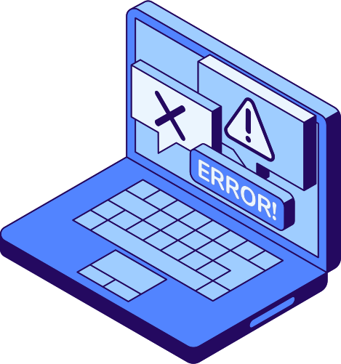
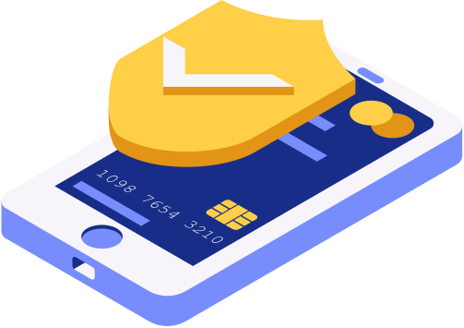

01/13
Studio Shodwe
Phishing Awareness: Spot It Before You’re Caught
A Guide to Recognizing and Avoiding Phishing Attacks
Name :: Vasita Krishna R
Internship Task 2
Student ID : CA/MY3/4449

Slide 2

02/13
Studio Shodwe
WHAT IS
Definition:
Phishing is a cybercrime where attackers pretend to be trustworthy entities (like banks or tech companies) to trick users into giving away personal data, login credentials, or financial info.
Why it's dangerous:
It can lead to identity theft, financial loss, or company data breaches.
PHISHING?
www.reallygreatsite.com

Slide 3



TYPES OF PHISHING ATTACKS
03/13
Email Phishing – Mass emails from fake accounts with malicious links or attachments.
Example: “Your account has been suspended. Click to verify.
2. Spear Phishing – Personalized emails targeting specific individuals.
Example: CEO impersonation emails.
3. Smishing – SMS messages with malicious links.
Example: “You’ve won a gift card! Claim here.”
4. Vishing – Voice calls pretending to be from support or banks.
Example : “This is your bank. Please verify your PIN.”
5. Clone Phishing – A previously legitimate email is copied and resent with a malicious link.

Slide 4

Red Flags:
04/13
Generic greetings like “Dear Customer”
HOW TO RECOGNIZE A PHISHING EMAIL
Urgent language or threats (“Immediate action required”)
Suspicious or misspelled email addresses
Unexpected attachments
Poor grammar, mismatched logos, or odd formatting

Slide 5



05/13
EXAMPLES OF PHISHING EMAILS
Show a screenshot of a fake PayPal or bank email
LHighlight red flags using circles/arrows
Compare with a legitimate version

Slide 6




How Social Engineering Works
06/13
Authority:
Urgency
Pretending to be CEO, HR, or IT
“You must act now!”
Fear:
Greed/Curiosity:
“Your account will be locked!”
: Fake job offers, invoices, or contests
Example: Fake email from "CEO" asking employee to wire money quickly

Slide 7

07/13
Studio Shodwe
SPOTTING FAKE WEBSITES
HOW ATTACKERS FOOL YOU:
Look-alike domains (e.g., www.faceb00k.com)
No padlock (🔒) or HTTPS
Poor design or incorrect logo
Fake popups asking for credentials

Slide 8


08/13
REAL-WORLD PHISHING EXAMPLES
Google Docs Phishing (2017)
Attackers sent fake “document share” emails that compromised accounts.
Sony Pictures Hack (2014)
Phishing emails helped attackers access internal systems.
Twitter Bitcoin Scam (2020)
High-profile accounts were
compromised
and used in a crypto scam.

Slide 9

09/13
Studio Shodwe
BEST PRACTICES TO AVOID PHISHING
Think Before You Click: Always verify the source
Use Multi-Factor Authentication (MFA)
Never Share Passwords or OTPs
Update Software Regularly
Report Suspicious Emails to IT/Security Team

Slide 10
10/13
Studio Shodwe
Anti-Phishing Filters in email clients
Browser Security Extensions like
Netcraft or Avast
Spam Protection Software
Company Awareness Training Programs
TOOLS THAT CAN HELP

Slide 11

SUMMARY
12/13
Phishing is widespread, clever, and evolving
Learn the signs — urgency, grammar, fake domains
Don’t trust blindly — verify before clicking or responding
When in doubt — report it!

Slide 12
TAKE THE QUIZ – TEST YOUR AWARENESS
12/13
Title: Ready to Test What You’ve Learned?
Click the link below to take a short interactive quiz on phishing awareness.
🔗 https://forms.gle/Dd6Dz5n4oFhGoj4Y8
💡 The quiz includes real-world scenarios and red-flag spotting to reinforce your learning.
Your responses help us improve training and ensure you’re phishing-proof!”

Slide 13
13/13
Studio Shodwe
THANK
YOU!

